Slide 1
Confronting the “Boogie Man” …The “Need to Knows” of Mold and Asbestos
S
NorHaz - Your partner in the safe removal of ASBESTOS, LEAD and MOLD

Slide 2
Confronting the “Boogie Man” …The “Need to Knows” of Mold and Asbestos
S
NorHaz - Your partner in the safe removal of ASBESTOS, LEAD and MOLD

Slide 3
What is your pain?
Dealing with MEDIA that has made Mold and Asbestos the “Boogie Man”
“Can vermiculite jump through the ceiling?” and other questions
Disclosure Statements – what about asbestos?
What are the implications of not dealing with asbestos?
How to inspect a house without “killing the deal”
Ensuring that your client TRUSTS your information
Where to look for potential mold ( Largest E&O surrounds missed mold)
Addressing the “freak out” factor
Avoiding liability

Slide 4
Desired Outcomes…
Provide you with SOLUTIONS to “Your Pain”
Empower you with ACCURATE INFORMATION so that you can speak with knowledge
Help you address your client’s FEAR FACTOR when it comes to hazardous materials
Give you a “GO TO” source to provide professional direction

Slide 5
“Boogie Man” #1 – Asbestos Did you know…

Slide 6
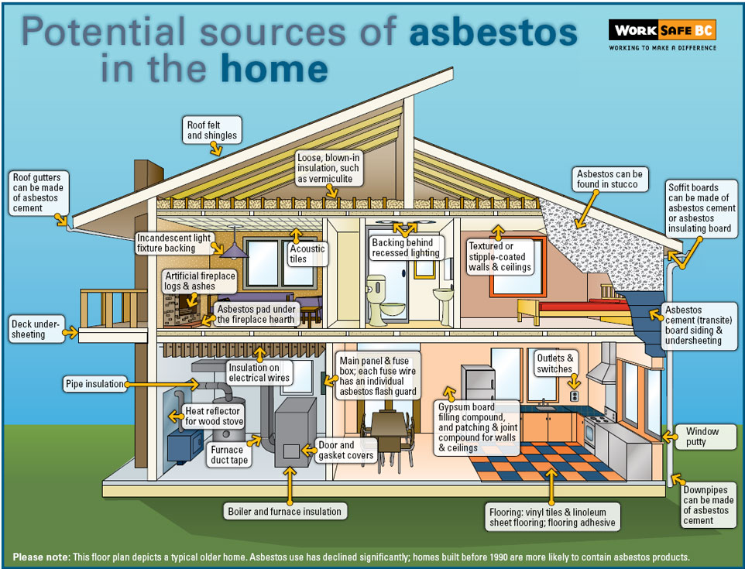
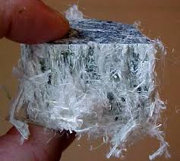
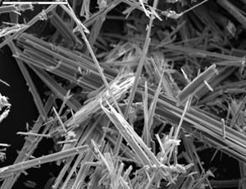
Prior to 1990, over 3000 building products contained ASBESTOS

Slide 7
What is asbestos?
A NATURALLY OCCURING silica mineral
Used because of it’s ABILITY to bond, resist heat, insulation value and low cost
FRIABLE – refers to the ease with which it releases fibers
Fibers are extremely fine and can stay AIRBORNE for hours
May cause SERIOUS HEALTH PROBLEMS such as chronic lung disease (asbestosis) and lung cancer (mesothelioma)

Slide 8
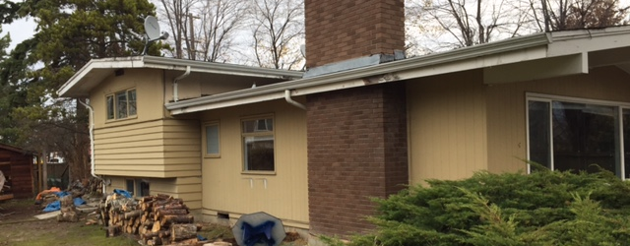
Where might I find asbestos in a house?

Slide 10
Vermiculite in attic
Two Kinds Of Vermiculite
South African
Libby / Asbestos

Slide 11
Vermiculite in floors

Slide 12
Vinyl Sheet Flooring

Slide 13
Stucco

Slide 14
Tape Joint Compound
S

Slide 15
Vinyl Floor Tile, Mastic & Leveling Compound

Slide 16
Stipple Texture Ceiling

Slide 17
Duct Wrap

Slide 18
WorkSafe BC Regulations Section 20.112

Slide 19
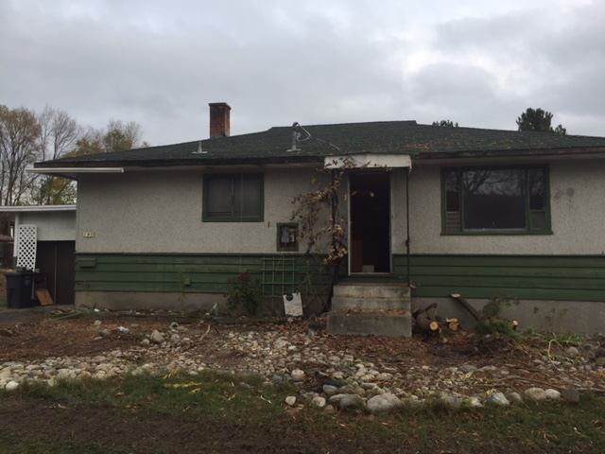
What does WorkSafe BC Regulations Section 20.112 say?
“(2) Before work begins on the demolition or salvage of machinery, equipment, a building or a structure, or the renovation of a building or structure, all EMPLOYERS responsible for that work, and the OWNER, must ensure that a qualified person inspects the machinery, equipment, building or structure and the worksite to identify the hazardous materials (May 1, 2017 – new regulations)
(8) A qualified person must ensure, and confirm in writing, that the hazardous materials identified under subsection (2) or (6) are safely contained or removed”

Slide 20
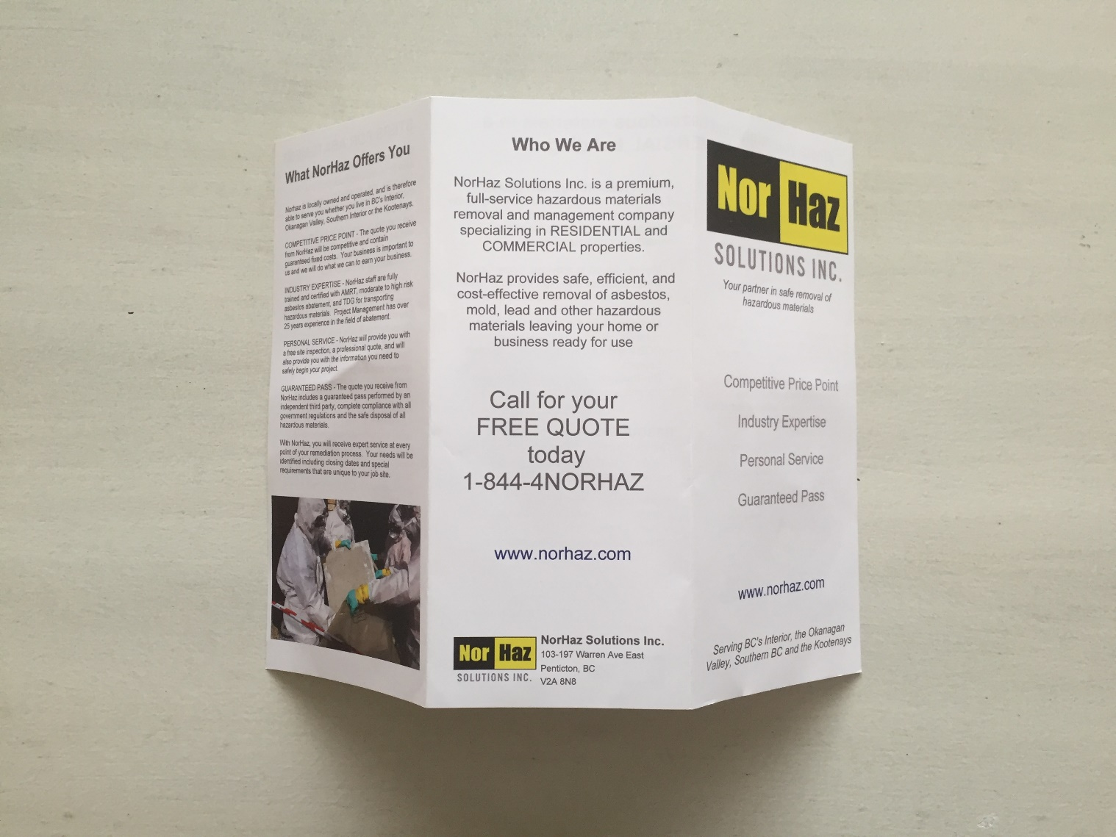
The Five Steps In Asbestos Abatement
Hazardous Material Survey
Risk Assessment
Abatement- HEPA sandwich
Clearance Testing
Renovation…

Slide 21
What is your pain?
Dealing with MEDIA that has made Mold and Asbestos the “Boogie Man”
“Can vermiculite jump through the ceiling?” and other questions
Disclosure Statements – what about asbestos?
What are the implications of not dealing with asbestos?
How to inspect a house without “killing the deal”
Ensuring that your client TRUSTS your information
Where to look for potential mold ( Largest E&O surrounds missed mold)
Addressing the “freak out” factor
Avoiding liability

Slide 22
The “Boogie Man”
Asbestos is ONLY hazardous in TWO situations
If it is being disturbed in such a way that fibers will be released into the air. ie: cutting, grinding, sanding etc
If it is in a poor state of repair so that fibers are released into the air.
Asbestos is safe to be around as long as its fibers are NOT being released into the air.

Slide 23
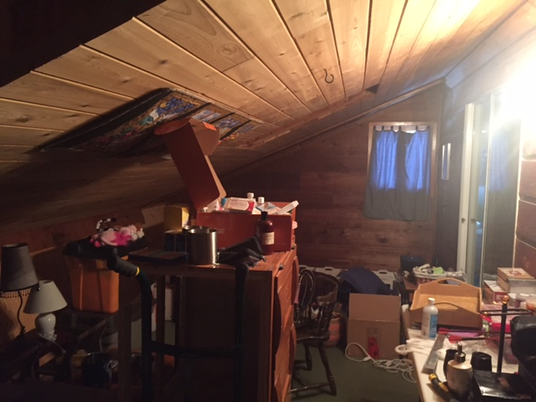
Can vermiculite jump through the ceiling?
S
There are three EFFECTIVE methods of dealing with asbestos
Encapsulating
Enclosing
Removing
Asbestos is safe to be around as long as its fibers are NOT being released into the air.

Slide 24
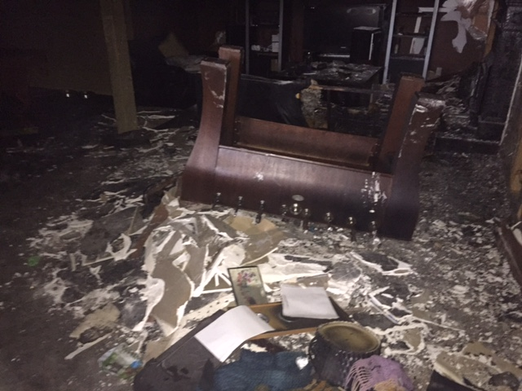
Disclosure Statements… a double edged sword
S
A material MUST be sampled to prove that it is it asbestos containing
Without sampling – it is ONLY a suspect material
Remember – prior to 1990, over 3000 building products contained asbestos
Any material that is .5% or greater is considered containing
EXCEPTION- vermiculite – must be proven to NOT contain asbestos

Slide 25
Implications of NOT dealing with Asbestos
MORTGAGE – Some agencies will NOT finance or insure a home that is known to contain asbestos.
RENOVATIONS – The reality is that a budget line needs to be included for the possibility of Hazmat abatement.
DEMOLITIONS – WorkSafeBC & Regional landfills are becoming more stringent in their rules for waste disposal.

Slide 26
Possible Disclaimer Statement
“According to WorksafeBC, prior to 1990, over 3000 building products were used that contained asbestos. If you are going to do any renovations, alterations or demolition to your house, you MUST first get a hazardous materials survey and have the identified materials professionally removed.”

Slide 27
What is your pain?
Dealing with MEDIA that has made Mold and Asbestos the “Boogie Man”
“Can vermiculite jump through the ceiling?” and other questions
Disclosure Statements – what about asbestos?
What are the implications of not dealing with asbestos?
How to inspect a house without “killing the deal”
Ensuring that your client TRUSTS your information
Where to look for potential mold ( Largest E&O surrounds missed mold)
Addressing the “freak out” factor
Avoiding liability

Slide 28
NorHaz Solutions Q&A
Your partner in the safe removal of ASBESTOS, Lead and MOLD

Slide 29
“Boogie Man” #2 – Mold

Slide 30
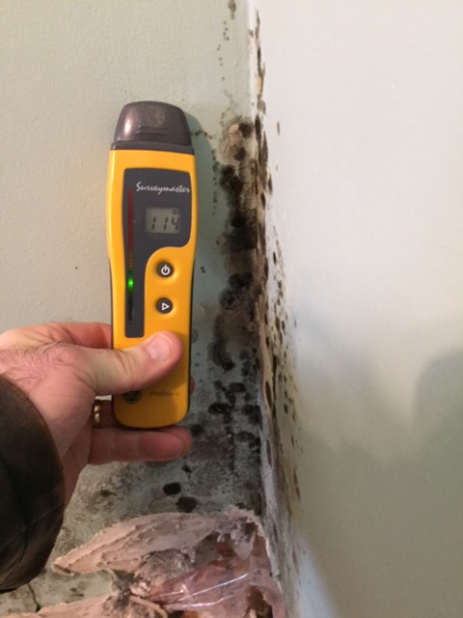
What about MOLD?

Slide 31
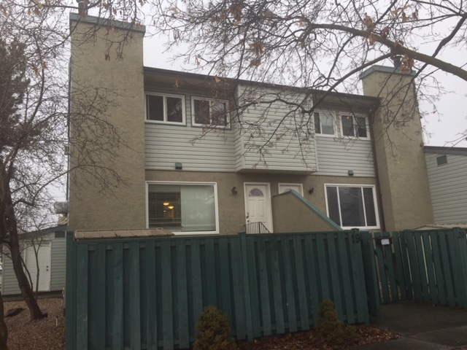
S

Slide 32
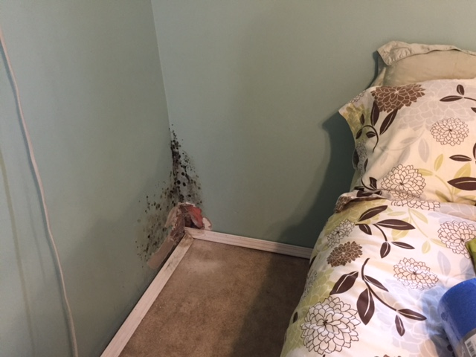

Slide 33
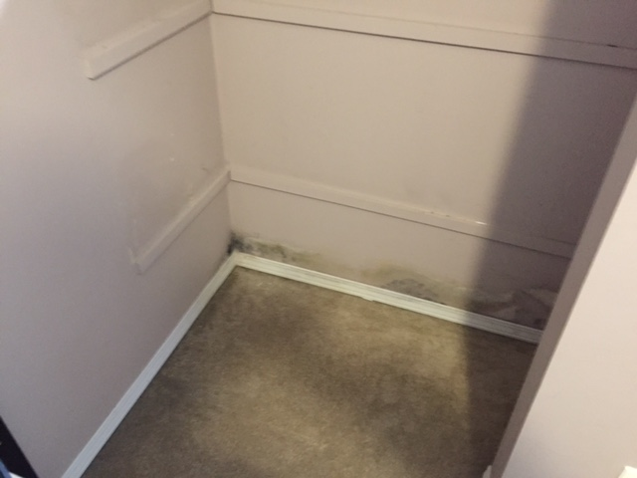

Slide 34
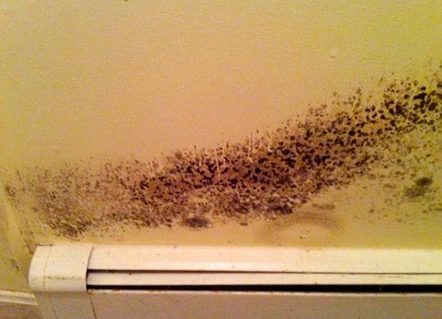
Mold Facts
Are simple small organisms found in/outdoors
Play an important role in the breakdown of organic compounds
People react differently to exposure (hay fever, asthma …)
Mould, carbon-monoxide and Radon are the top three causes of poor indoor air quality
Will grow within 72 hours in ideal conditions
Affected by: air circulation, moisture, food source, time and temperature
Over 100,000 species have been identified

Slide 35
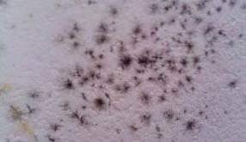
Mold Facts
A colony of spores = .
“Killing” a mould spore does NOT decrease your health hazard
Bleaching mould is hazardous to your health
Viable and non-viable spores
Stachybotrys, Aspergillus, and Penicillium

Slide 36
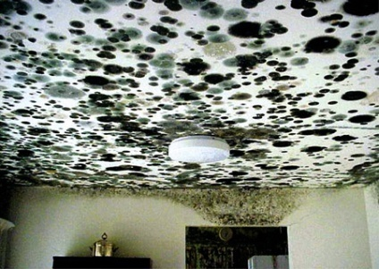
Mold Regulations
Mould is excluded from many insurance policies
However:
If mould is present (regardless of insurance coverage) contractors are bound by WorkSafe Regulations and must take suitable precautions

Slide 37
Mold Regulations
Worksafe BC Guideline G4.79, January, 2002 revised February 2007
3 Levels of remediation based on quantity of mould present (not visible)
Consultant and trained contractor must be retained for all projects where there is more than 10 square feet of mould present.

Slide 38
Mold Regulations
Disposal of hazardous materials is regulated by MOE (Ministry Of Environment) regulations
Mold is considered a hazardous material
Improper disposal has potentially significant liability implications for owners
Manifesting helps protect owner once materials leave the owners site / control

Slide 39
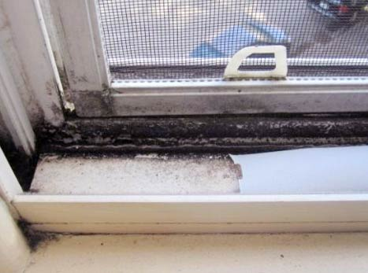
Mold – Level 1
S
Under 10 SF
Non-inhabitable space
PPE
Half face mask P95
Does NOT have to be qualified

Slide 40
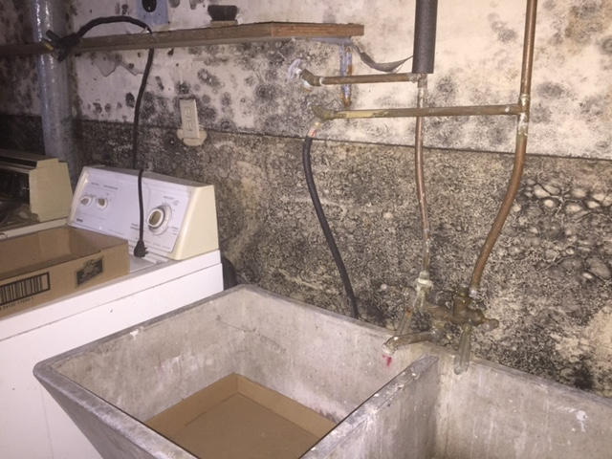
Mold – Level 2
Between 10-100 SF
MUST be Qualified
PPE
Full face PAPR (powered air purifying respirator) P100
Containment
Negative Air

Slide 41
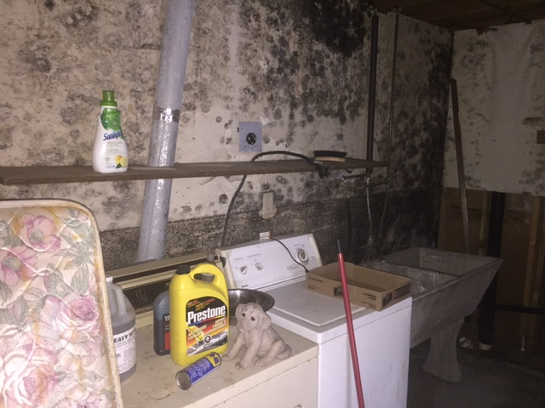
Mold – Level 3
Over 100 SF
MUST be Qualified
PPE
Full face PARP (powered air purifying respirator) P100
Containment
Negative Air
Decontamination Chamber
Possible air testing

Slide 42
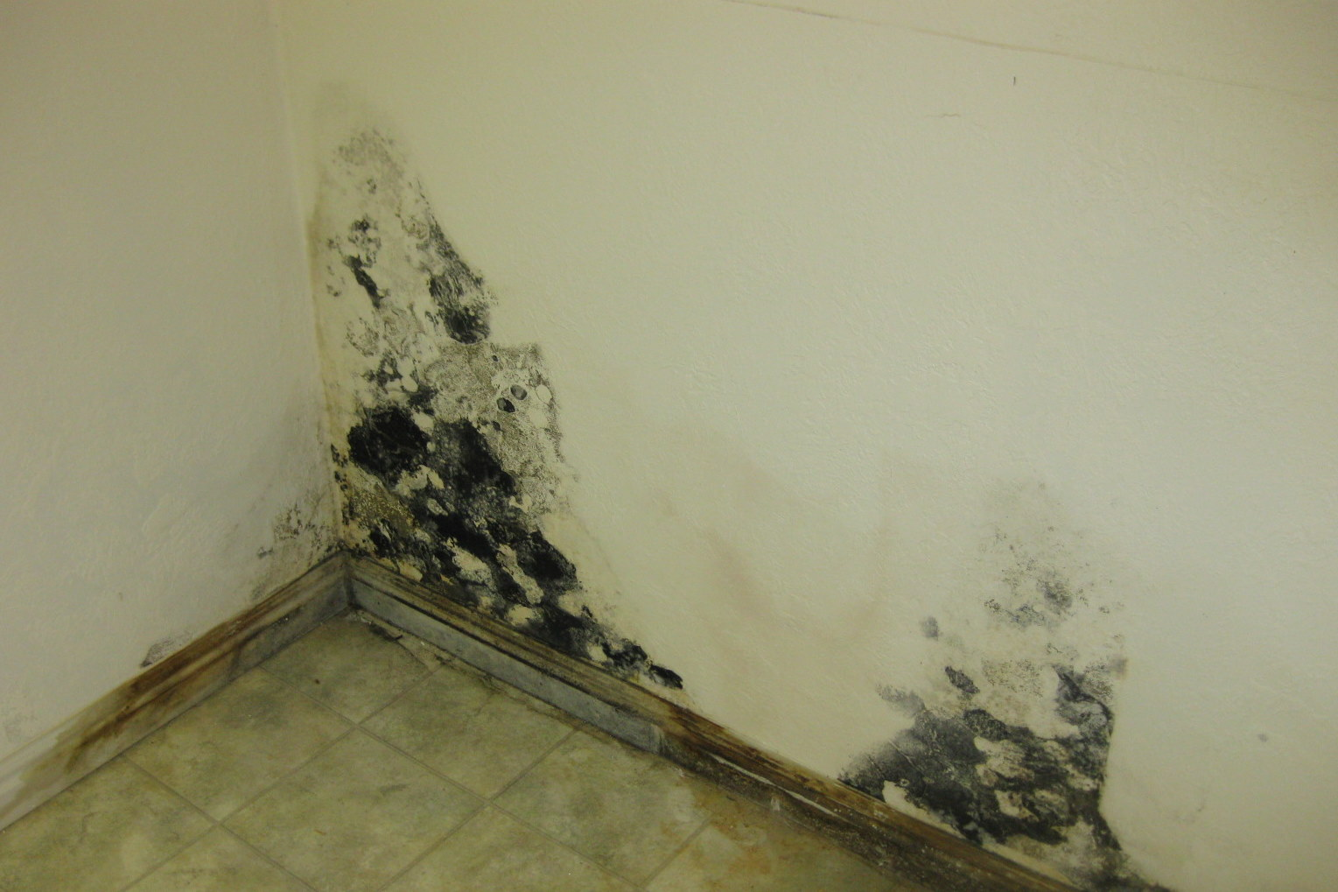
Dealing With MOLD
1. Look for Any Source Of Moisture – Mold needs at least three factors to grow: Moisture, Food Source and Stale Air. Controlling the moisture will control the mold.

Slide 43
Dealing With MOLD
2. Anything Under 10SF Can Be Cleaned

Slide 44
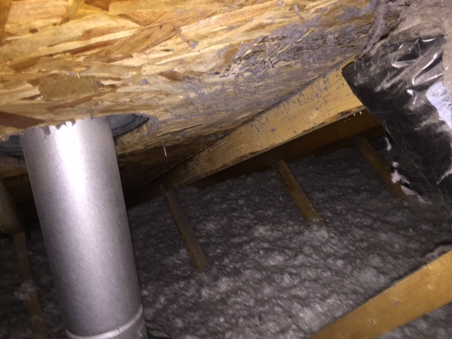
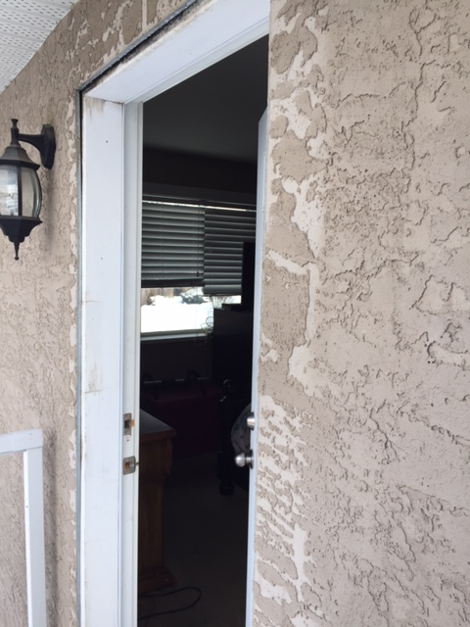
Dealing With MOLD
3. Differentiate Between habitable and non-inhabitable spaces

Slide 45
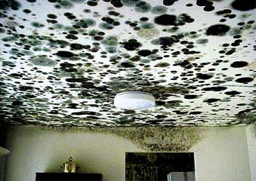
Dealing With MOLD
4. Call NorHaz for a free quote on anything over TEN SQUARE FEET.

Slide 46
Inspecting a house… without killing the deal
Juggling all parties - buyers, sellers, realtors, home inspectors, trades…
Don’t escalate the emotion
Provide information
Offer solutions

Slide 47
What is your pain?
Dealing with MEDIA that has made Mold and Asbestos the “Boogie Man”
“Can vermiculite jump through the ceiling?” and other questions
Disclosure Statements – what about asbestos?
What are the implications of not dealing with asbestos?
How to inspect a house without “killing the deal”
Ensuring that your client TRUSTS your information
Where to look for potential mold ( Largest E&O surrounds missed mold)
Addressing the “freak out” factor
Avoiding liability

Slide 48
NorHaz Solutions Q&A
Your partner in the safe removal of ASBESTOS, Lead and MOLD

Slide 50
When you renovate a home
Automatic Flag – Any building built prior to 1990 must be tested for asbestos if materials are going to be disturbed.
Budget – for the possibility of asbestos abatement.
Survey - Have the room surveyed for asbestos.
Get a FREE QUOTE – if samples come back positive

Slide 51
WorksafeBC Cracks Down…
WorkSafeBC conducted 210 site inspections last year and found 43 per cent of hazardous material surveys done by contractors were inadequate, the agency said Tuesday. WorkSafeBC officers wrote 257 orders for hazardous materials violations and imposed 20 penalties.

Slide 52
WorksafeBC Cracks Down…
"They are not doing complete surveys. They might identify one wall ... but what about the other walls? What about the floor tile, duct material, taping compounds, installation? We need them to do a thorough risk assessment."
Penalties vary depending on payroll, so larger companies pay more for infractions. They can range from $1,000 up to $30,000.
Johnson said 77 workers died in 2014 from asbestos-related diseases. "While asbestos does not pose a health risk when left undisturbed, preventable exposures can cause fatal lung diseases with symptoms developing many years later," he said.

Slide 53
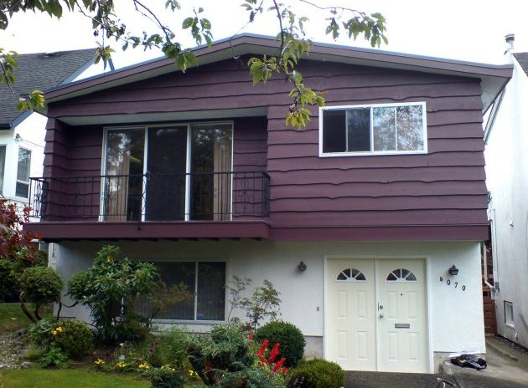
What are all the Possible Risks of Hazardous Materials in Homes?
Health impact on workers and occupants
Significantly increased costs related to assessment and safe handling
Delays (costs)
Litigation for improper removal

Slide 54
Assessment
Should sampling take place, here are examples of three types of sampling processes, but are not limited to.
Air sampling – the most common form of sampling to assess the levels of mold present in the air. Sampling of both indoor and outdoor air is conducted and the results to the level of mold spores inside and outside are compared.
Surface sampling – swab, tape and dust samples are taken and tested for the amount of spores deposited on indoor surfaces
Bulk samples – the removal of materials from the contaminated area to identify and determine the concentration of mold in the sample.

